Slide 1
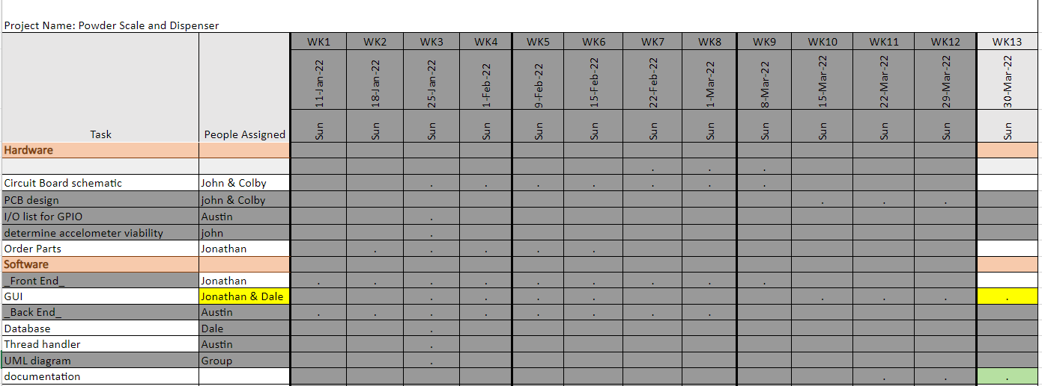
Week 12 (23-Mar to 29-Mar) Austin Stecklein

Slide 2
Week 12 (23-Mar to 29-Mar) Austin Stecklein
Goal/Task | % Done | Hours (Act.)
Backend linking | 50% | 4
Haptic and speaker connected | 100% | 2
Demo building | 100% | 4
Steps to set up the demo and environment | 100% | 3
Hours on task during the week (On track ≥ 13 / wk) | 13
Total hours on task so far this semester (On track ≥ 150 hrs) | 150

Slide 3
Progress made during the week (Log) (What I did)
Haptic and speaker are working and can be easily added to the frontend calls.
While working with Dale and Johnathan we got the frontend to run on beaglebone. Problem was import names and locations
With the help of John got the demo connected in a manner that will allow for testing all the current features at once. (touch, screen, reading from scale, controlling stepper motors, and haptic/speaker)

Slide 4
Difficulties encountered during the week (What I did not do and why)
Prototype stepper was slipping in the 3D printed gear.

Slide 5
Goals for this coming week (Ones that move the project forward the most)
Goal/Task | Stop Date (Est.) | Hours (Est.)
Documentation for backend software | 4/4 | 4
Film demo /poster | 4/4 | 4
clean up code and add finishing touches | 4/4 | 5
Estimated time needed to work on goals for this coming week (typ. 13 hrs) | 13

Slide 6
Week 12 (23-Mar to 29-Mar) Jonathan Phillips
Goal/Task | % Done | Hours (Act.)
Front end – Ensuring Code Runs on Every Machine | 100 | 4
Front end – UI Touch Ups | 87 | 4
Front end - Documentation | 91 | 5
Front end - Testing | N/A | 2
Hours on task during the week (On track ≥ 13 / wk) | 15
Total hours on task so far this semester (On track ≥ 150 hrs) | 142

Slide 7
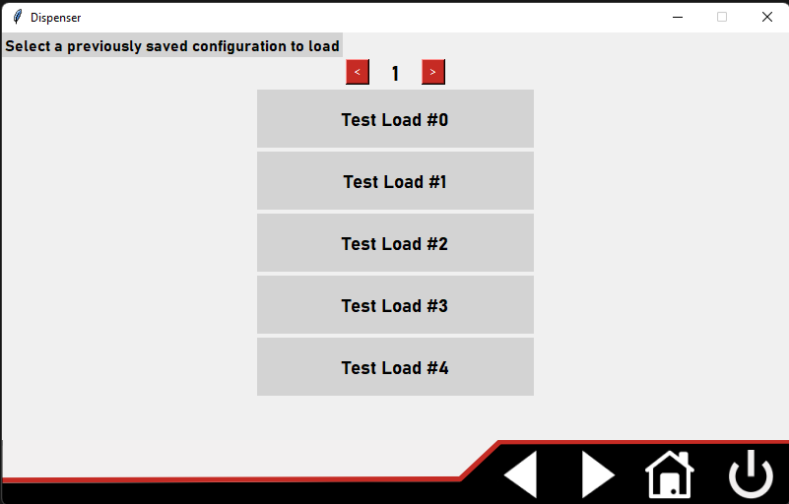
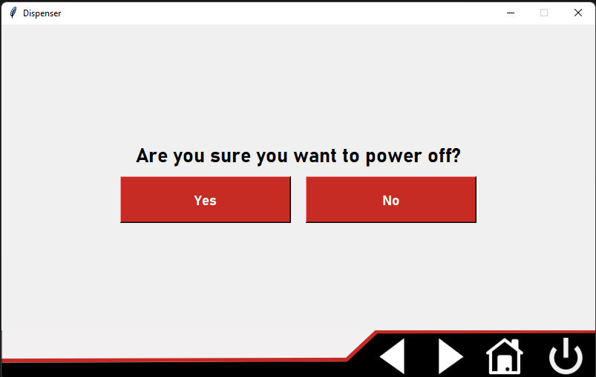
Progress made during the week (Log) (What I did)
Comments, Comments, and even more Comments!!

Slide 8
Difficulties encountered during the week (What I did not do and why)
Changing the <,> Buttons on some of the Pages
When an image was added, the button functionality stopped working

Slide 9
Goals for this coming week (Ones that move the project forward the most)
Goal/Task | Stop Date (Est.) | Hours (Est.)
Front end – Changing the <,> Buttons to Images | 4/4/22 | 4
Front end - General Progression | 4/4/22 | 4
Front end - Documentation | 4/4/22 | 3
Front end - Testing | 4/4/22 | 2
Estimated time needed to work on goals for this coming week (typ. 13 hrs) | 13

Slide 10
Week 12 (23-Mar to 29-Mar) - Dale Andreoli
Goal/Task | % Done | Hours (Act.)
Finalize layout/fonts/images |  | 3
Comments / improve organization |  | 4
Work with Austin to finalize the backend |  | 4
Project Objective / Mission Statements
Power Scale Dispenser:
Design, build, and test the electronics for the dispenser with a touch screen display and controlling two stepper motors by April 6, 2021 with a prototyping budget of $1000 USD and for less than 600 people-hours.
Hours on task during the week | 11
Total hours on task so far this semester | 146

Slide 11
Progress made during the week (Log) (What I did)
Continued comments and improved organization
UI is now running on the beaglebone with the touch screen and can control the motor

Slide 12
Difficulties encountered during the week (What I did not do and why)
Backend function that controls motor only turns it on
Easy fix in the works

Slide 13
Goals for this coming week (Ones that move the project forward the most)
Goal/Task | Stop Date (Est.) | Hours (Est.)
Finish comments/written documentation |  | 6
Finalize fonts/images |  | 2
Work with Austin to finish and test backend for final demo |  | 6
Estimated time needed to work on goals for this coming week | 14

Slide 14
Week 12 (23-Mar to 29-Mar) Colby Hatton
Goal/Task | % Done | Hours (Act.)
Documentation | 90% | 9
Alternate Components | 100% | 4
Hours on task during the week (On track ≥ 13 / wk)
Total hours on task so far this semester (On track ≥ 150 hrs)

Slide 15
Progress made during the week (Log) (What I did)
Wrote out the documentation for our project. This included our parts, challenges, future recommendations, and so forth.

Slide 16
Difficulties encountered during the week (What I did not do and why)
LibreOffice leave a lot to be desired, and MS office is closed source spyware. Life is tragic.

Slide 17
Goals for this coming week (Ones that move the project forward the most)
Goal/Task | Stop Date (Est.) | Hours (Est.)
Create presentation | 4 April 2022 | 10
Miscellaneous tasks, etc. | 4 April 2022 | 4
Estimated time needed to work on goals for this coming week (typ. 13 hrs) | ~14

Slide 18
How can we help you achieve your goals?
Pizza party?

Slide 19
Week 12 (23-Mar to 29-Mar) John Stinger
Goal/Task | % Done | Hours (Act.)
Finish Documentation | 90% | 9
Completely Outline hang-ups |  | 2
Set up demo hardware |  | 2
Hours on task during the week (On track ≥ 13 / wk) | 13
Total hours on task so far this semester (On track ≥ 150 hrs) | 128

Slide 20
Progress made during the week (Log) (What I did)
For example: Resources found (links, manuals), Designs created, Decisions made and corresponding rational, Photos of prototype progress, etc.
Documentation is more or less done.
Helped set up the demo hardware

Slide 21
Difficulties encountered during the week (What I did not do and why)
USB port didn’t supply power

Slide 22
Goals for this coming week (Ones that move the project forward the most)
Goal/Task | Stop Date (Est.) | Hours (Est.)
Continue setting up the Demo Hardware |  | 3
Review the Documentation |  | 2
Estimated time needed to work on goals for this coming week (typ. 13 hrs) | 5

Slide 23
How can we help you achieve your goals?
Is there anything else we can do?

